Slide 1

Methodology: Selecting Participants
AEPSY Year 11 ATAR Psychology

Slide 2
Review
What is the difference between a population and a sample?
With sampling methods, what is meant by bias?
Which sampling method is least biased?
Which sampling method is most biased?
Explain the convenience sampling method and give one advantage and one disadvantage of the method.

Slide 3
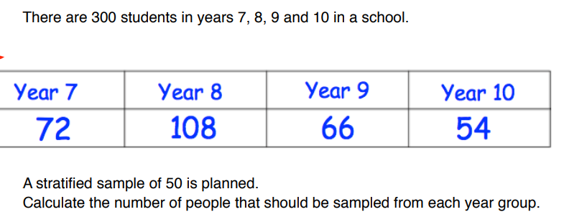
Review
6.

Slide 4
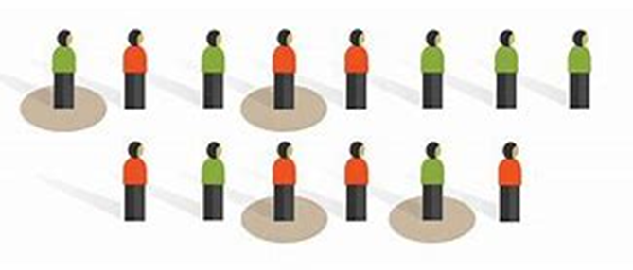
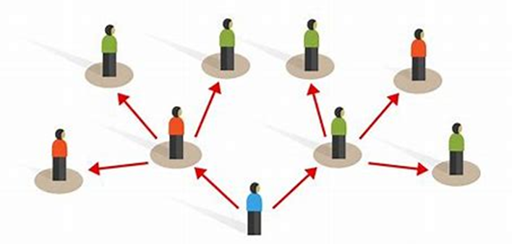
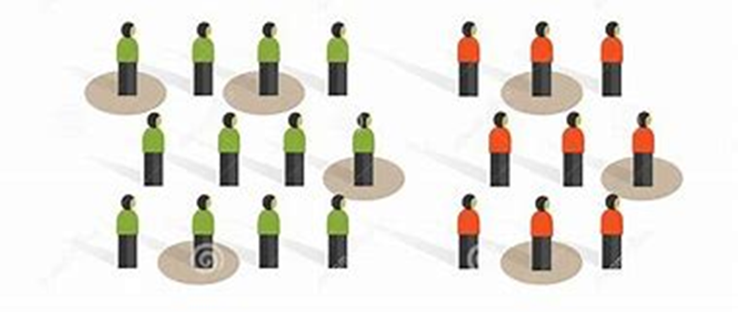
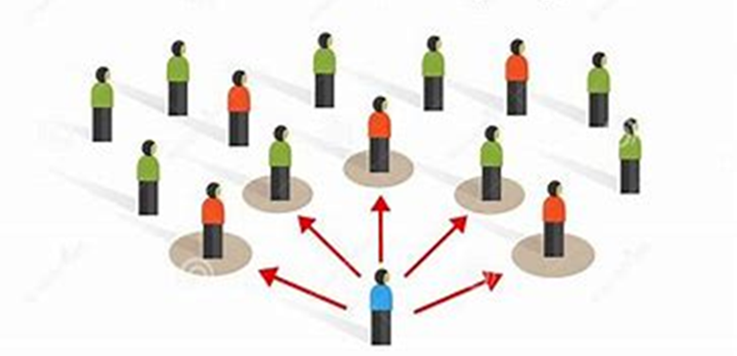
Review
7. What sampling technique is represented by each of these diagrams?

Slide 5
Learning Intentions
random allocation of participants – application, method, strength and limitations

Slide 6
Success Criteria
Define random allocation
Explain why random allocation is important
Explain how random allocation is determined or applied.

Slide 7
Random Allocation
Sample participants will be allocated to groups, such as control and test group.
Random allocation is when the researchers divide the participants and allocate them to certain groups using a random method. For instance, in an experiment to test the effects of a new drug on depression the researchers might use a random number generator to assign their 25 participants a number from 1 – 25. They could then put all the odds in one group and the evens in another.

Slide 8
Advantages
Random allocation greatly decreases systematic error, so individual differences in responses or ability are far less likely to affect the results.

Slide 9
Selective allocation
When allocating participants selectively the researchers “select” who will go in each group based on a particular criteria. In the example above, for instance, there might be 8 females and 17 males so the researchers want to make sure that the number of female participants is equal in both groups so that gender is not a confounding variable. They would then make sure they chose four females to be in each group.

Slide 10
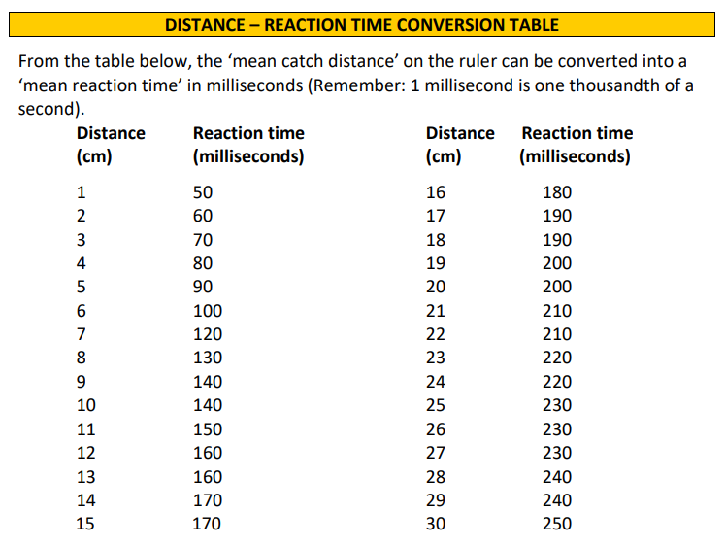

Slide 11
Success Criteria
Define random allocation
Explain why random allocation is important
Explain how random allocation is determined or applied.

